Slide 1

DATE : 22.06.2022
Government College Of Engineering, Salem-11.
Department Of Computer Science And Engineering.
18CS605 / Mini Project
WEB-BASED STUDENT FEEDBACK SYSTEM
Team Members:
K.M. Dinesh. (1921014)
S. Ravindhranath. (1921037)
R. Vikram. (1921052)
Team Guide:
Dr. C. Rani, M.E., Ph.D.,
Assistant Professor,
Computer Science and Engineering Dept,
Government College of Engineering, Salem.

Slide 2
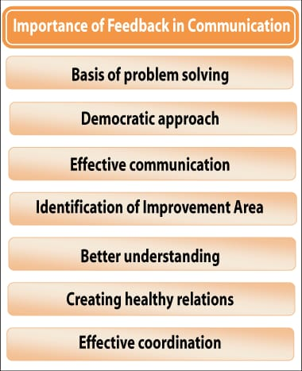
OBJECTIVE
Feedback is the valuable information that will be used to make important decisions.
Feedback is important more important because, it is used to analyse the past activities and when there is a need to update the progress, it will be more helpful.
In simple words our phone needs updation periodically likewise without feedback any progress cannot be upgraded.

Slide 3
ABSTRACT
The “Web-based student feedback system ” is developed to collect the feedback from the students using a responsive website.
The main advantage of this mini project is, that there is permanent storage medium for storing the responses. Which are used for the future improvements in the progress.
After collecting feedback from various students, The overall responses are summarised using two-dimensional bar graph. In this graph the admin can view the overall performance of the academic staff’s.

Slide 4
INTRODUCTION
The main aim of this mini project is to collect the feedback in easier and quick manner.
This website will be more user-friendly and the students can be easily use this website and give their responses.
This web development project is grouped into four phases.
1. Front view implementation
2. Backend completion.
3. Storing the responses in database.
4. Providing overall responses.

Slide 5
EXISTING SYSTEM
In the Existing system there is lack of User-Interface, also the feedbacks are collected using excel file and there is no proper storage of that responses .
These overall responses are not easier to analyse since it involves lot of manual works.
There is no online medium to store the overall data, because it has no permanent storage databases.

Slide 6
PROPOSED SYSTEM
In our new proposed system there is an advantage that, the students are able to give their feedback responses using online mode.
The students can easily give their responses in website, and they can communicate with the website using rich user interfaces.
The feedback collected from these websites are transferred to the cloud databases to store permanently.

Slide 7
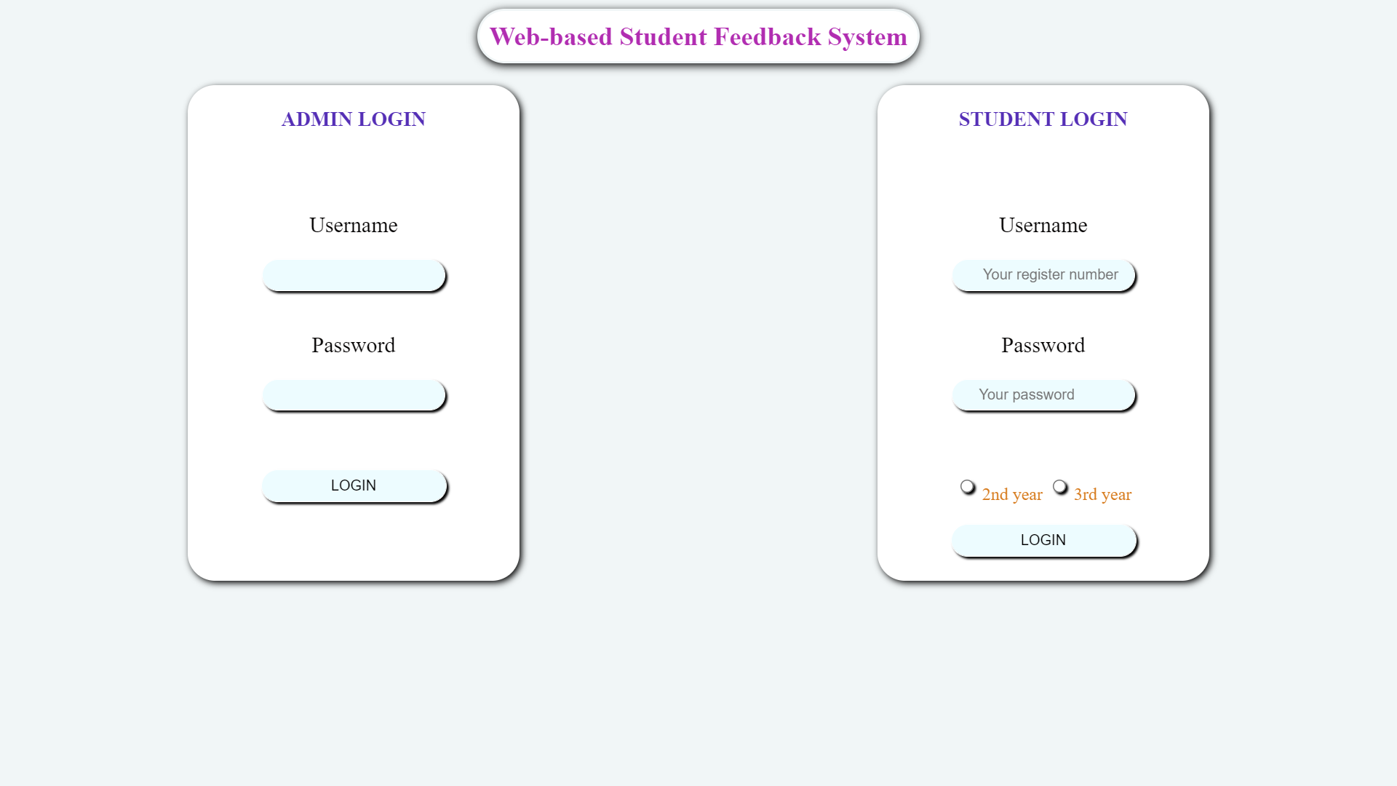
MODULES DESCRIPTION
LOGIN MODULE

Slide 8
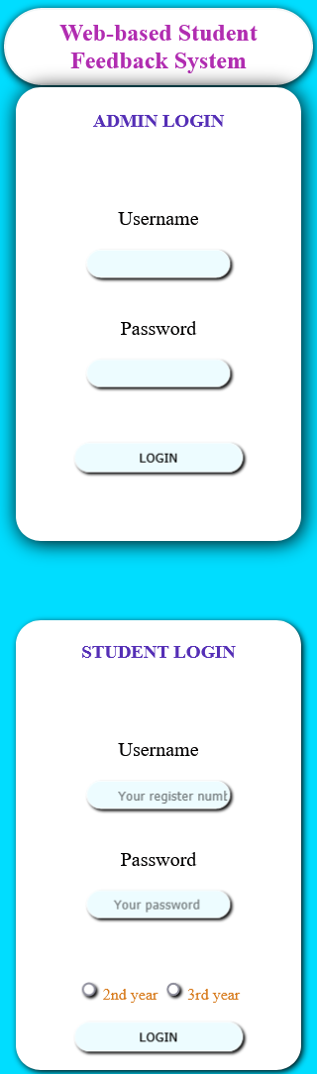
MOBILE VIEW OF LOGIN MODULE

Slide 9
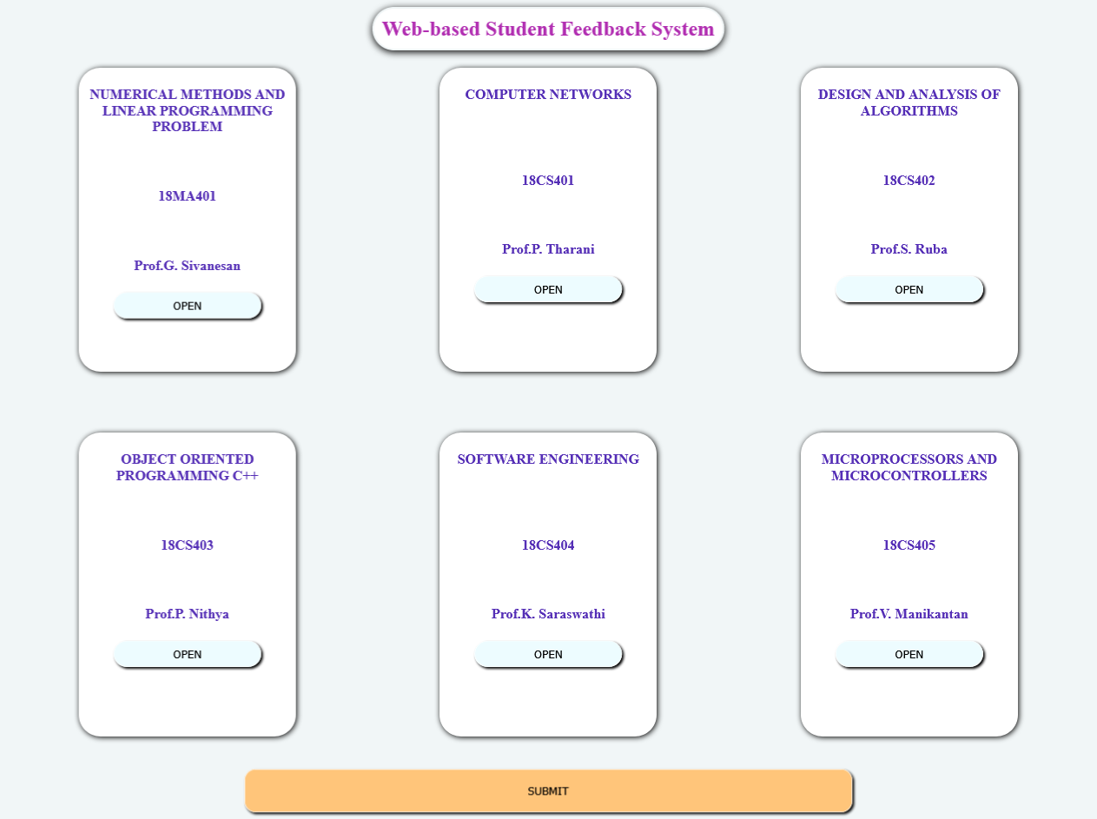
HOME PAGE FOR OVERALL SUBJECTS

Slide 10
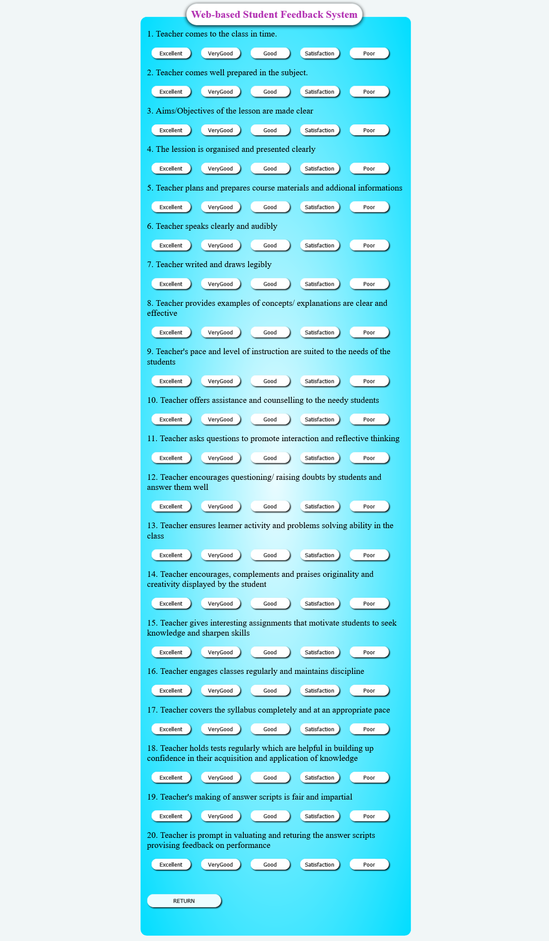
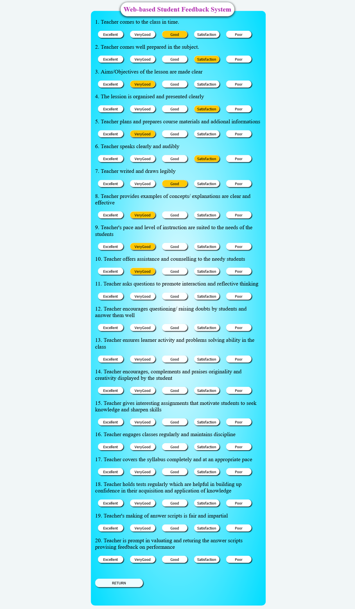

ASSESMENT MODULE FOR STUDENTS

Slide 11
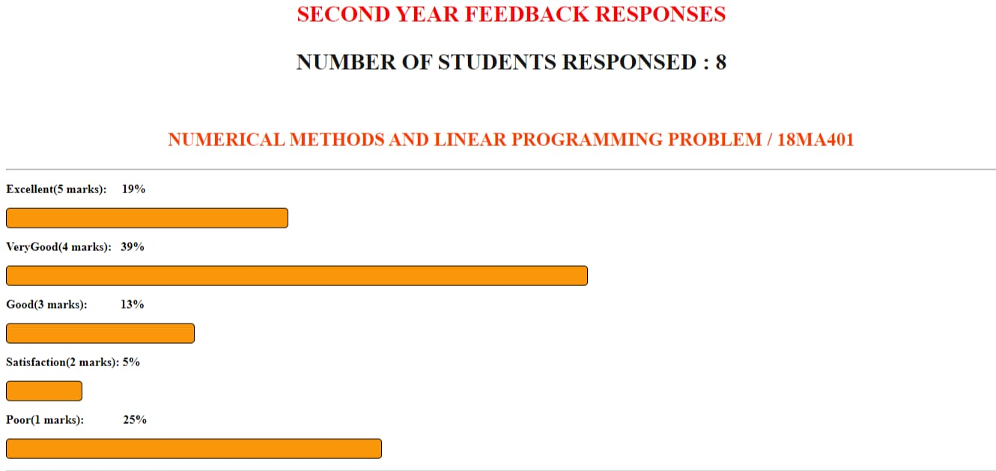
CATEGORY WISE RESULTS

Slide 12
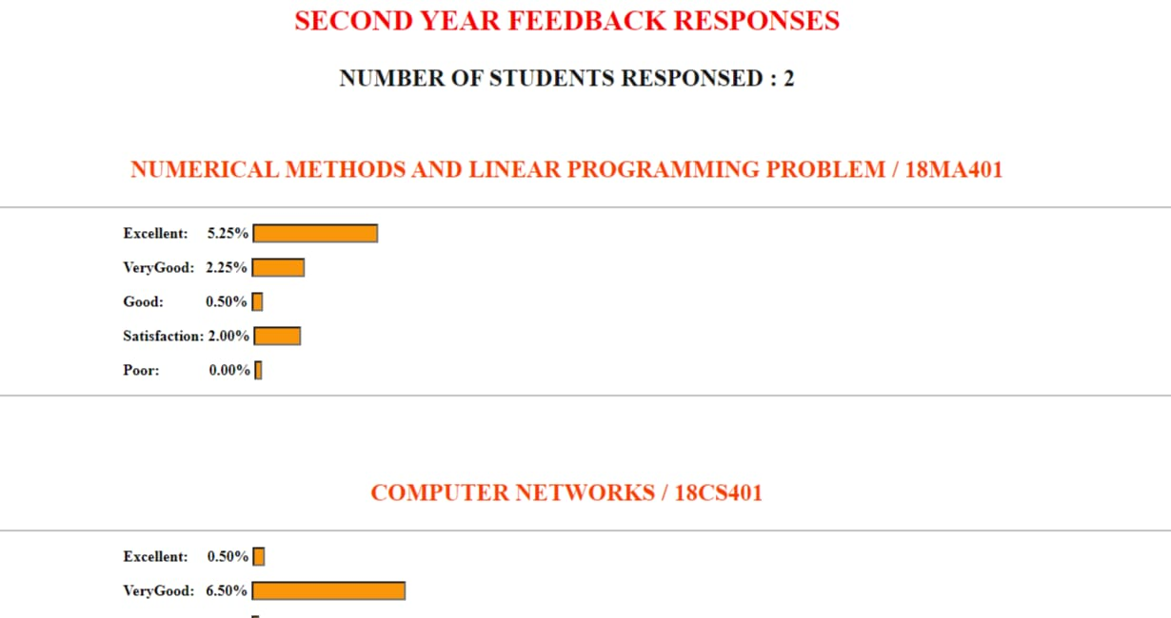
Overall results

Slide 13
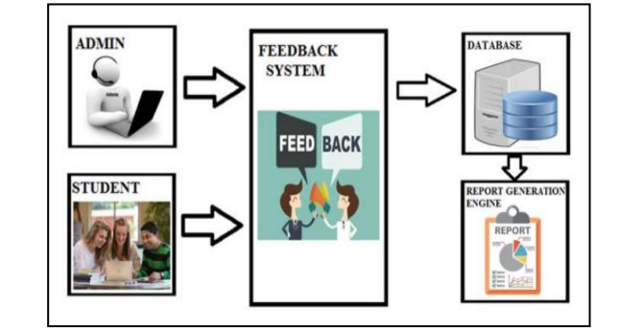
ARCHITECTURE

Slide 14
Software and Techniques Used
Visual Studio Code Editor
Web Browser
HTML
CSS
NodeJS
ExpressJS
JavaScript
MongoDB

Slide 15
Thank you !

